Slide 1
Emre Ozmen
Challenging the implicit bias: An application of linear regression with NLP for churn prediction
February, 2021

Slide 2
Reasoning
100 years old corporate business operations was first built on thousands of years military learnings, where data science started first with medical needs.
Although the application areas for both fields are wide-spread today, more than ever, they still reflect the nuances of their predecessors, in one way or another.
Those nuances sometimes might be considered favorable, sometimes unfavorable.
In other words, sometimes it helps for the purpose with leading factors, sometime the opposite is more true, it is a lagging factor which also makes the objective of this paper.

Slide 3
Proposals
P1: Scrutinizing an Implicit Bias: Can LinearRegression be used for a classification problems?
P2: AUC Optimization: Can decreasing precision or recall help us? Per churn’s Type-I receptive (unlike spam email detection) nature, bursting the ‘false alarm’ by trading off with false negative
P3: Battle of Fuzzy Logic vs Binary Classification: In the sake of KDD’s ‘emphasizing the "high-level" application’ of datasets, promoting the utilization of probabilities instead of traditional binary classification
P4: Feature Engineering with NLP: Make customer feedbacks a part of features

Slide 4
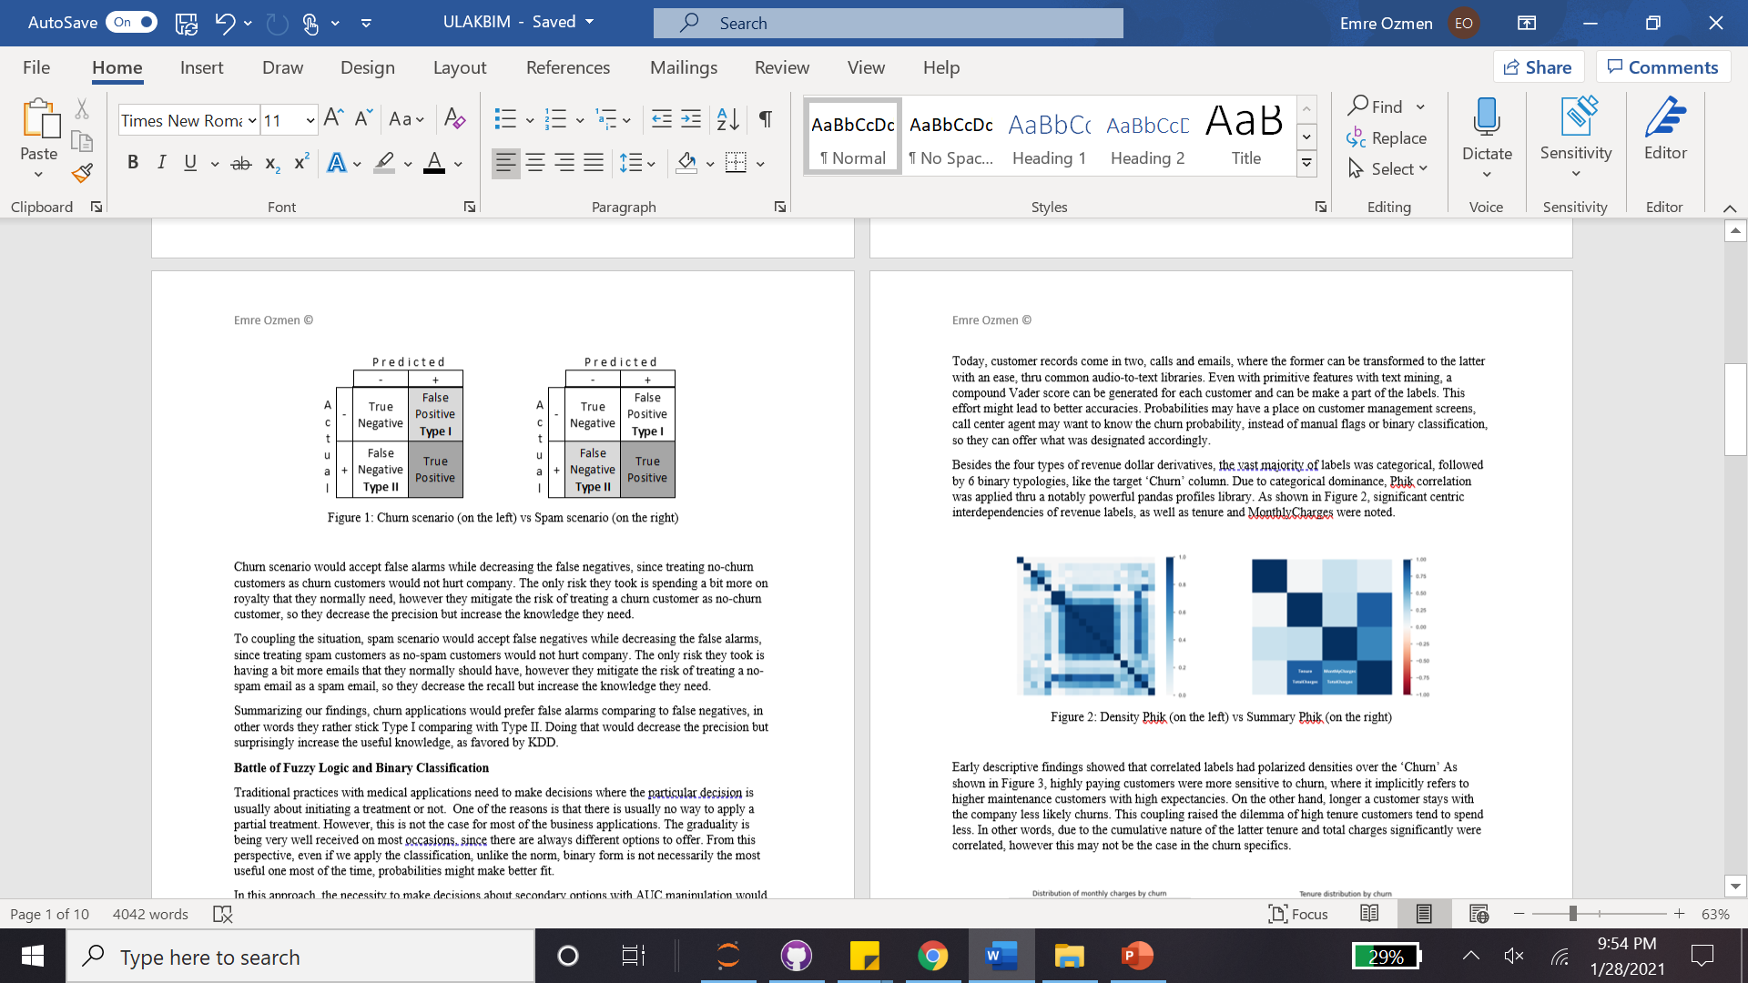
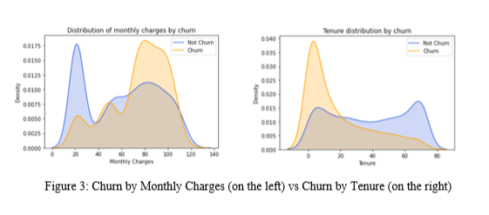
Early Findings

Slide 5
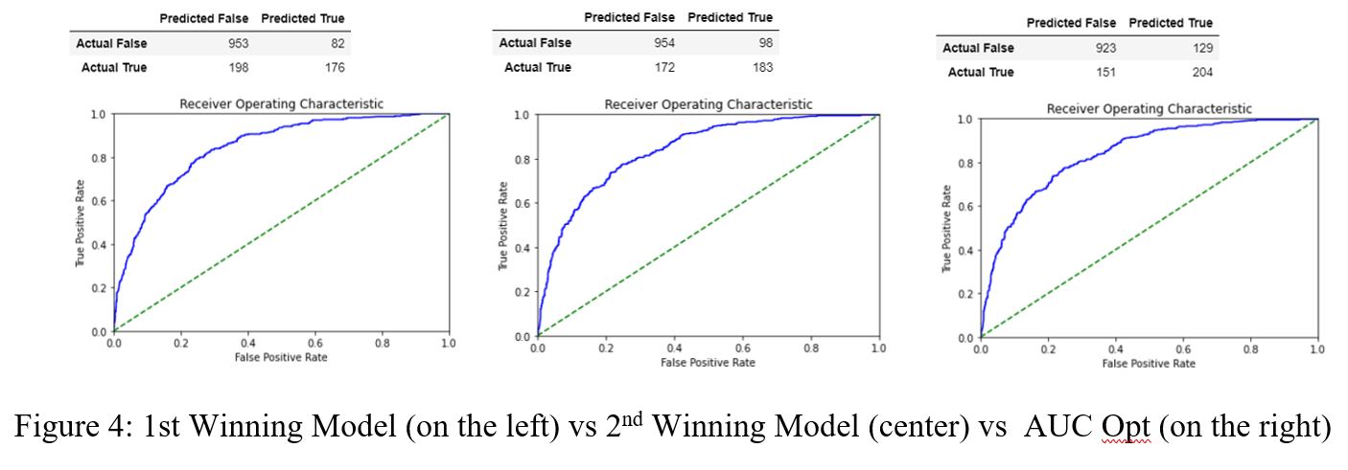
First ML Round
GB Classifier, 0.50 Tolerance | Accuracy = 0.80 | Precision = 0.68 | Recall = 0.47
Lin Regressor, 0.5 Tolerance (RMSE = 0.44) | Accuracy 0.81 | Precision = 0.65 | Recall = 0.52
Lin Regressor, 0.45 Tolerance (RMSE = 0.45) | Accuracy 0.80 | Precision = 0.61 | Recall = 0.58

Slide 6
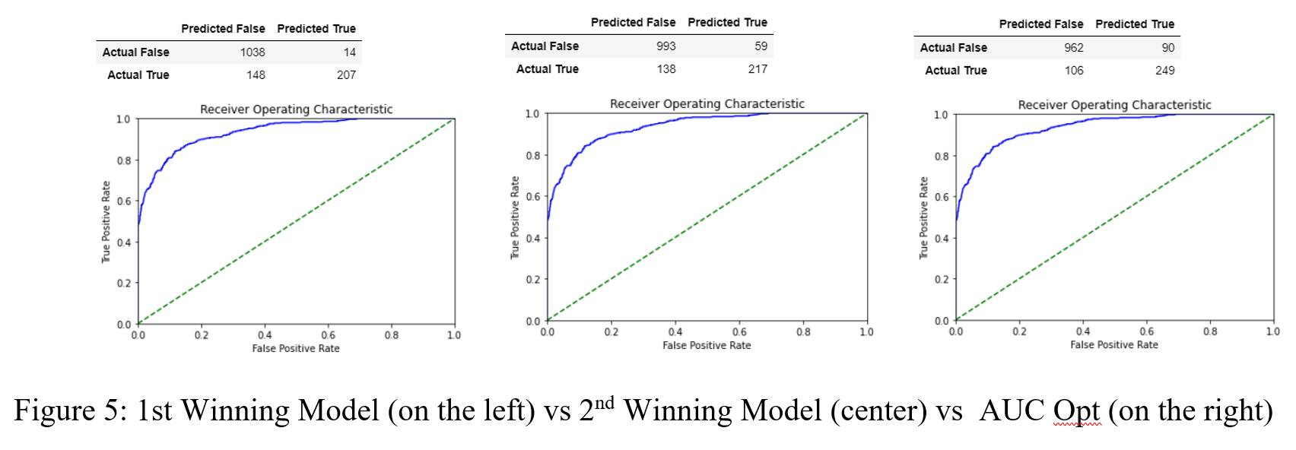
Second ML Round – Feature Engineering with NLP
XGB Classifier, 0.50 Tolerance | Accuracy = 0.89 | Precision = 0.94 | Recall = 0.58
Lin Regressor, 0.5 Tolerance (RMSE = 0.38) | Accuracy = 0.86 | Precision = 0.79 | Recall = 0.61
Lin Regressor, 0.45 Tolerance (RMSE = 0.37) | Accuracy = 0.86 | Precision = 0.73 | Recall = 0.70

Slide 7
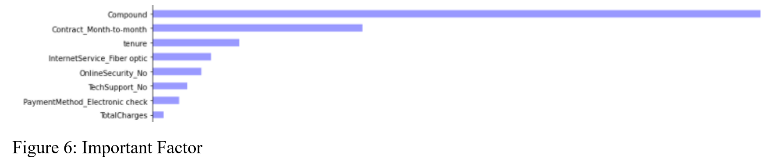
Second ML Round – Feature Engineering with NLP
Missed churn numbers decreased around 50%, from 196 to 106 customers
Re-estimated churn numbers were increased around 50%, from 176 to 249
Technicality stand point, the whole tripartite was augmented, from 8% to 50%
- Accuracy = 0.80 | Precision = 0.68 | Recall = 0.47 (Traditional “winning” approach)
- Accuracy = 0.86 | Precision = 0.73 | Recall = 0.70 (Nonconformist approach)

Slide 8
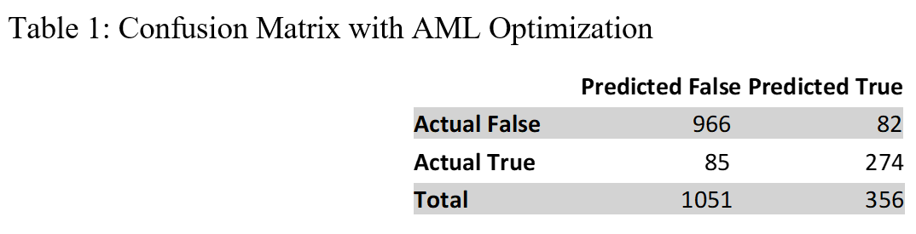
AML Optimization
Missed churn numbers decreased around 20%, from 106 to 86 customers
Re-estimated churn numbers were increased around 10%, from 249 to 274
Technicality standpoint, the whole tripartite was augmented, up to 50%
- Accuracy = 0.89 | Precision = 0.73 | Recall = 0.70
- Accuracy = 0.89 | Precision = 0.77 | Recall = 0.78

Slide 9
Hypothesis Building
H1. Being more receptive in model bias, including regressors, validates the churn model
H2. Favoring recall performance improves the churn model
H3. Respecting graduality (probabilities rather than 0 and 1) in classifiers improves the churn model
H4. Working with customer feedback for predicting customer churn improves the churn model

Slide 10
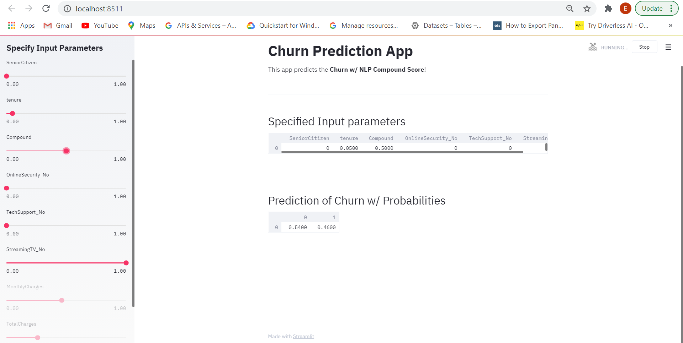
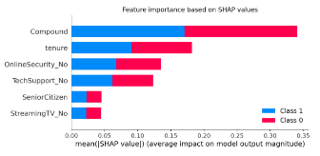
Churn Predictor in Production with Streamlit

